Slide 1


SOCIAL BUZZ ANALYSIS

Slide 2


Today’s agenda
Project recap
Problem
The Analytics team
Process
Insights
Summary

Slide 3

Social Buzz is a fastest growing technology unicorn that need to adapt quickly to its global scale.
Accenture has begun three month POC focusing on these tasks.
(1)An audit of their big data practice.
(2)Recommendations for a successful IPO.
(3)An analysis to find Social Buzz's top 5 most popular categories of content.
Project Recap

Slide 4

Problem
No. of posts per day is > 100000
No. of posts per year > 36500000
How to capitalize this and make it profitable?
Analyse to find Social Buzz’s top 5 most popular content categories.

Slide 5



Andrew Fleming
Chief Technology Architect
The Analytics team
Marcus Rompton
Senior Principle
Bhavya Sharma
Data Analyst

Slide 6
Process
1
Data Understanding
2
Data Cleaning
3
Data Modelling
4
Data Analysis
5
Data Visualization and Provide Insights

Slide 7
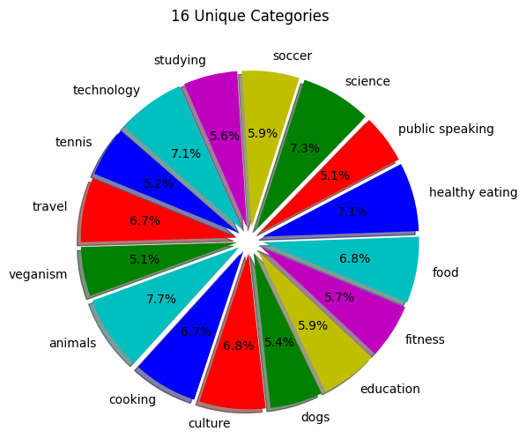
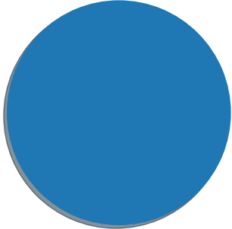

Insights
16 Unique Categories
Reaction to Animal Posts
MAY
1897
Month with Maximum Posts

Slide 8
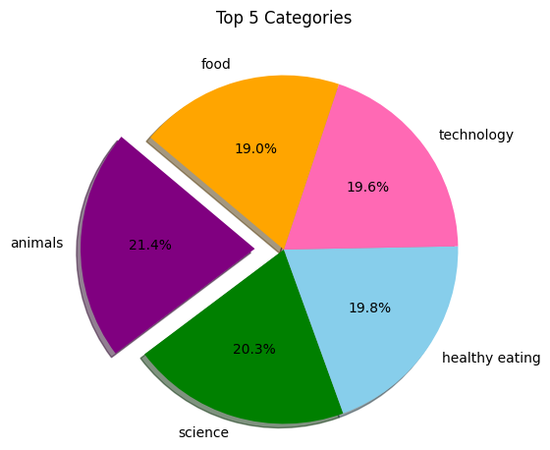
Top 5 Content Categories with Scores
66676
68738
74965
69339
71168

Slide 11

The top 5 categories in descending order are:
Animals
Science
Healthy eating
Food
Technology
The category with the highest number of reactions was- Animals
The month with maximum number of posts- May
Summary

Slide 12
Thank you!
ANY QUESTIONS?

